Slide 1
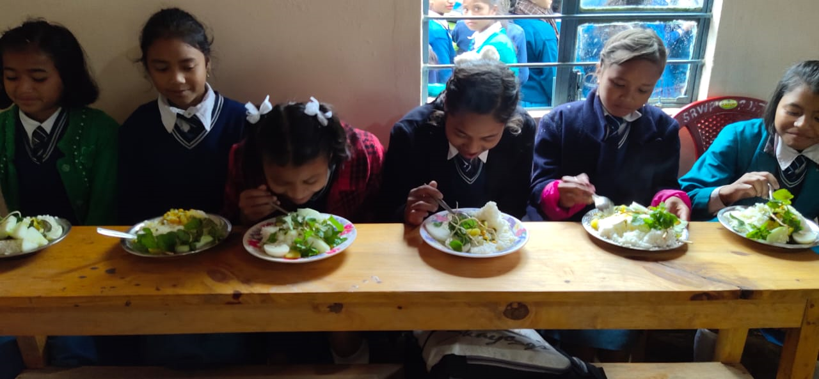
MID DAY MEAL SCHEME MEGHALAYA
Annual Work Plan & Budget
2020-21
Notes:
1

Slide 2
Good Practices
The State Government has established a Corpus Fund amounting to Rs. 10 crores to avoid any delay in releasing of funds to school.
E-Transfer of Mid Day Meal Funds such as Conversion cost and honorarium of Cook-cum-Helpers directly from the State Level to the School’s bank account and Cook-cum-Helper’s personal account respectively.
Wide Publicity in All India Radio Shillong, Tura and Jowai and in AIR FM Jongphi 103.6 Mhz from Aug-Nov, 2019. The Broadcast is being done in English, Khasi and Garo (Local language).
Local Chef Competition in Mawmihthied East Khasi Hills Sohra-Division.
Local Food Festival in Mawmihthied East Khasi Hills Sohra-Division.
Best Practice Award

Slide 3
Initiatives Taken
MDM fund to the school is being done through E-transfer directly from the Directorate to the Districts/Sub-Divisional/Bank Account of the Schools and to the Personal Bank Account of the Cook-cum-helpers.
Corpus fund of Rs.10 crore is maintained and used as and when fund is awaited from Government of India. (Corpus fund of Rs.10 Cr is available)
100% Payment to FCI.
During 2019-20, fund has been released to the Districts/Schools/ Cook-cum-helpers upto the month of March 2020.
100% Payment of Transportation Assistance Upto the month March 2020.
Coverage of 129.09 % of School Health Programme in 2019-20.
622 Kitchen devices replacement is in progress in 2019-20

Slide 4
Contd….
Social Audit : During the financial year 2019-20, Social audit was conducted in two districts namely Ri Bhoi District and West Jaintia Hills District. Social Audit was conducted in 650 schools from Ri Bhoi District and 912 schools from West Jaintia Hills District.
Only the minutes of the social Audit Public Hearing held in Jirang block and Laskein block have been received from the Social Audit Agency on 3.3.2020.
(Glimpse of the Findings Click)
During closure of Schools for preventing the spread of COVID-19, the state has taken the Initiatives for providing Foodgrain and Cooking Cost to the parents of the Student in all Schools Availing Mid Day Meal Scheme in the State as per entitlement. (Details Click)

Slide 5
State Issue
Enhancement of honorarium to cook-cum-helpers from Rs.1000/- per month to Rs.3,000/- per month for 12 Month in order to retain cook-cum-helper in the schools
Data Entry into the MIS Portal.
Automated Report Monitoring System (ARMS).

Slide 6
Performance During 2019-20

Slide 8
Physical Achievement 2019-20
1.Number of Schools
Category | Total No. of existing Institutions | Coverage | % Vs. Institution
Pry | 8376 | 8264 | 98.66%
U.Pry | 3427 | 3414 | 99.62%
Total | 11803 | 11678 | 98.94%
2. Number of Children
Component | Enrolment as on 30.9.2019 | PAB Approval 2019-20 | Average no. of Children Covered | % Coverage Vrs PAB | % Coverage Vrs Enrolment
Children (Pry) | 415093 | 385399 | 384816 | 99.85% | 92.71%
Children (U.Pry) | 177232 | 148353 | 148714 | 100.24% | 83.91%
Total Children | 592325 | 533752 | 533530 | 99.96% | 90.07%

Slide 9
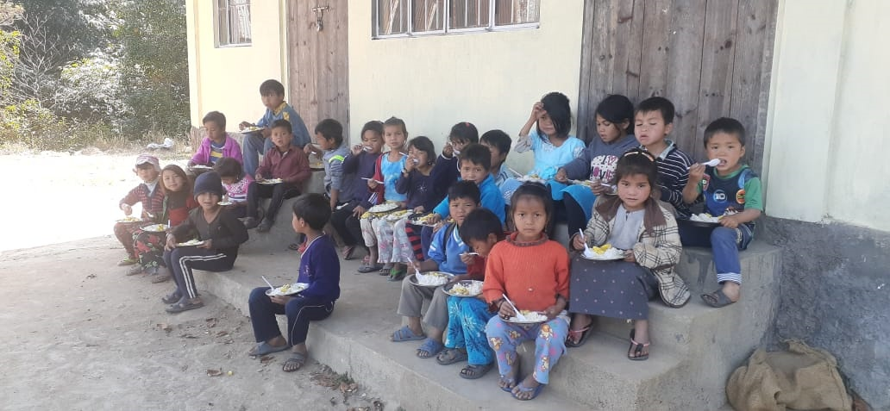
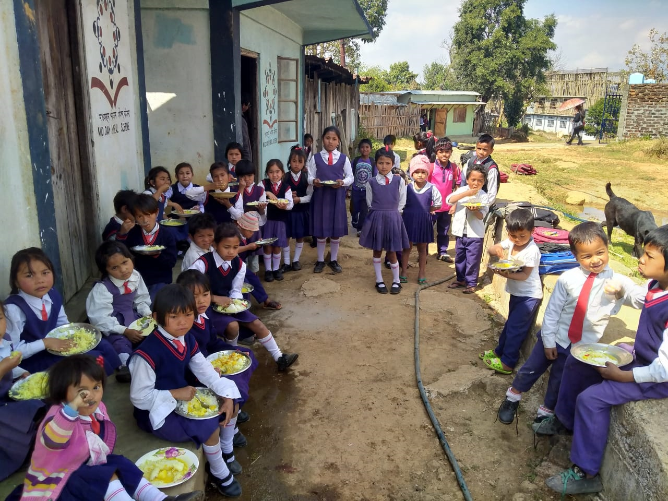
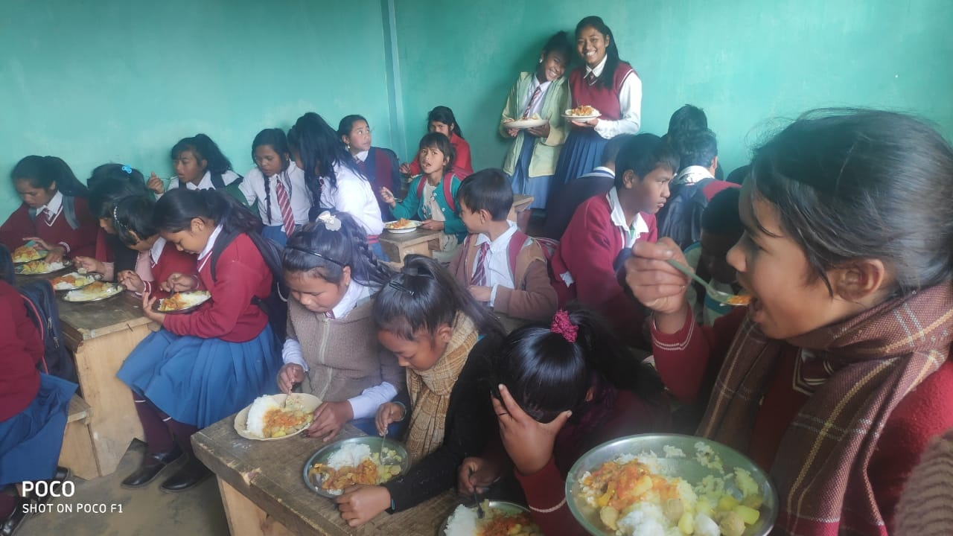

Slide 10
Contd..
3. Cook-Cum-Helpers
Stage | CCH PAB Approval | No. of cooks appointed | Gap Due to frequent Change of CCH | %
2 | 3 | 4 | 5 | 6
Primary | 13455 | 13392 | 63 | 99.53%
U Primary | 5092 | 5008 | 84 | 98.35%
Total | 18547 | 18400 | 147 | 99.21%
4. Foodgrain (In MTs)
Allocation | OB | Lifting | Consumed | Balance | %
12603.63 | 368.89 | 10006.16 | 9618.32 | 756.73 | 76.31%

Slide 11
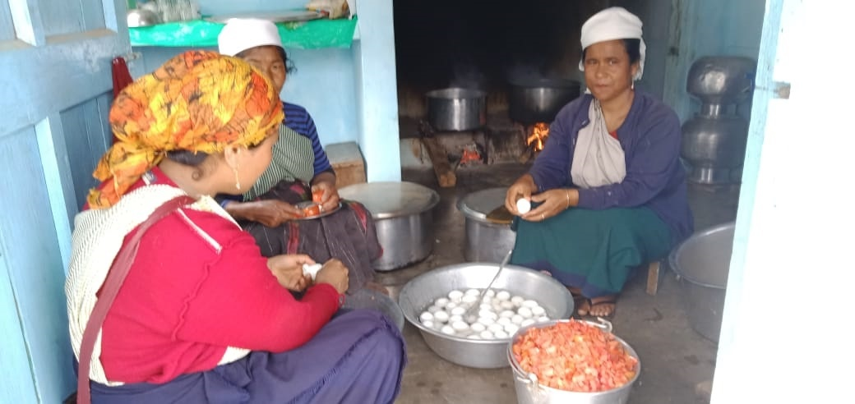
Cook-cum-helpers

Slide 12
Contd..
5. Construction of Kitchen Sheds
Years | Target (Units Sanctioned) | Constructed | In Progress | Not Started
2006-07 to 2011-12 | 9491 | 9491 | 0 | 0
2018-19 | 267 | 0 | 267 | 0
6. Procurement of Kitchen Devices
Years | Target (Units Sanctioned) | Procured | In Progress | Not yet procured
2 | 3 | 4 | 5 | 6
2007-2020 (New) | 12173 | 12089 | 0 | 84
2011-2020 (Replacement) | 10612 | 10074 | 0 | 538

Slide 13
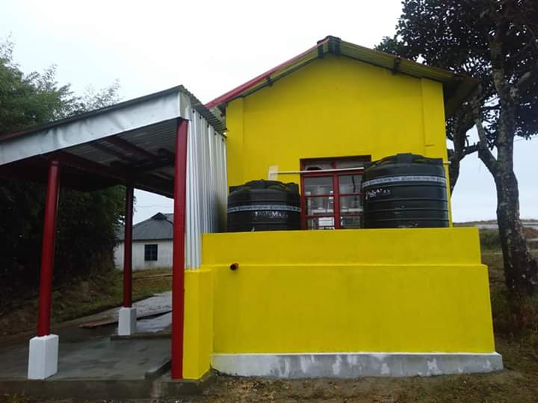
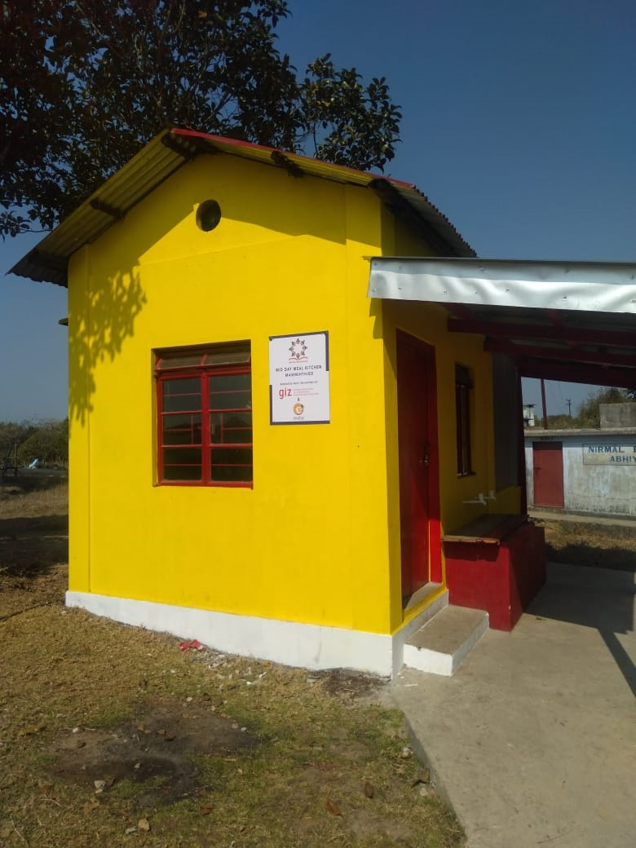
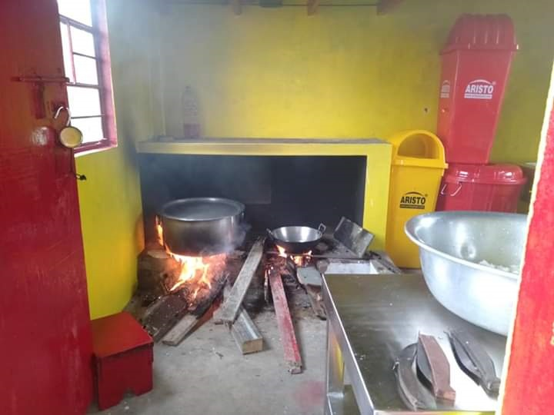
East Khasi Hills
Sohra Division - Khatarshnong
Mawmihthied Govt. LPS

Slide 14
6. School Health Programme (SHP)
Year | Total children to be covered under SHP | Total children covered under SHP | % Coverage
2019-20 | 592325 | 764612 | 129.09%
Year | Weekly Iron & Folic Acid Supplementation (WIFS) | Deworming tablets distributed | Distribution of spectacles
2019-20 | 171345 | 485295 | Reports awaited from DHS

Slide 15
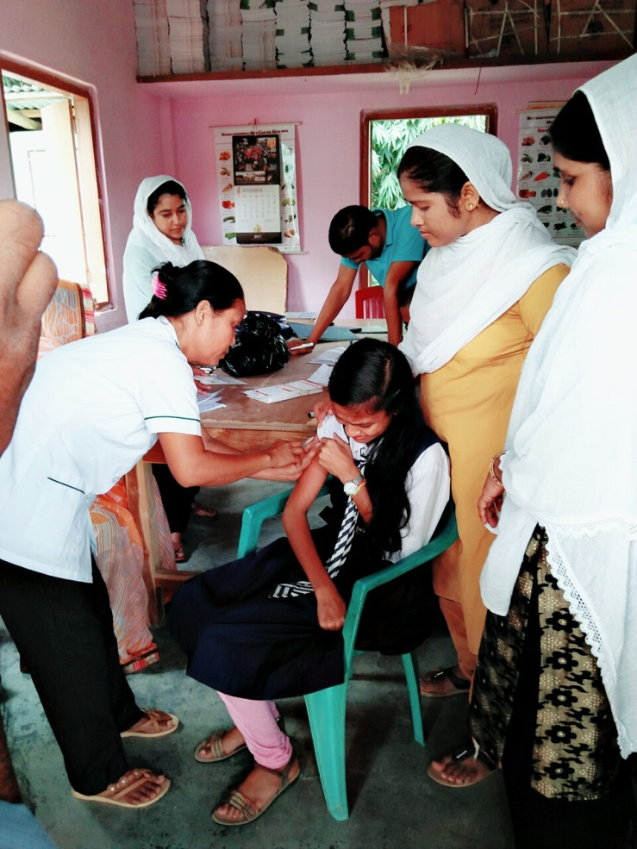
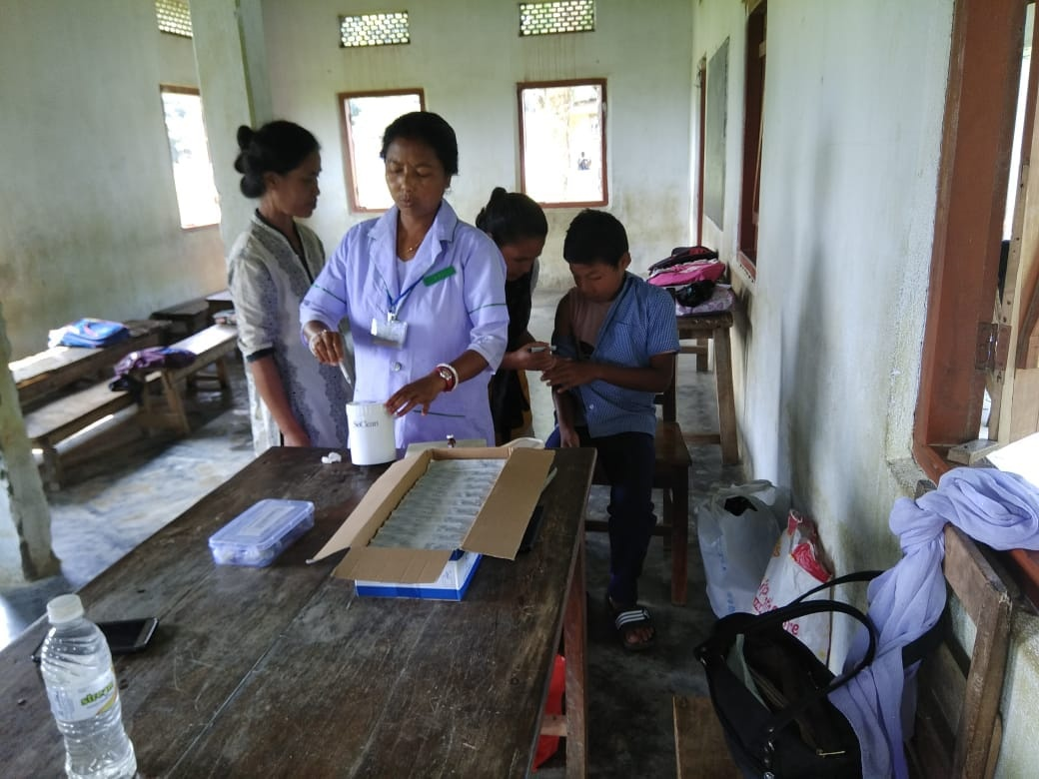
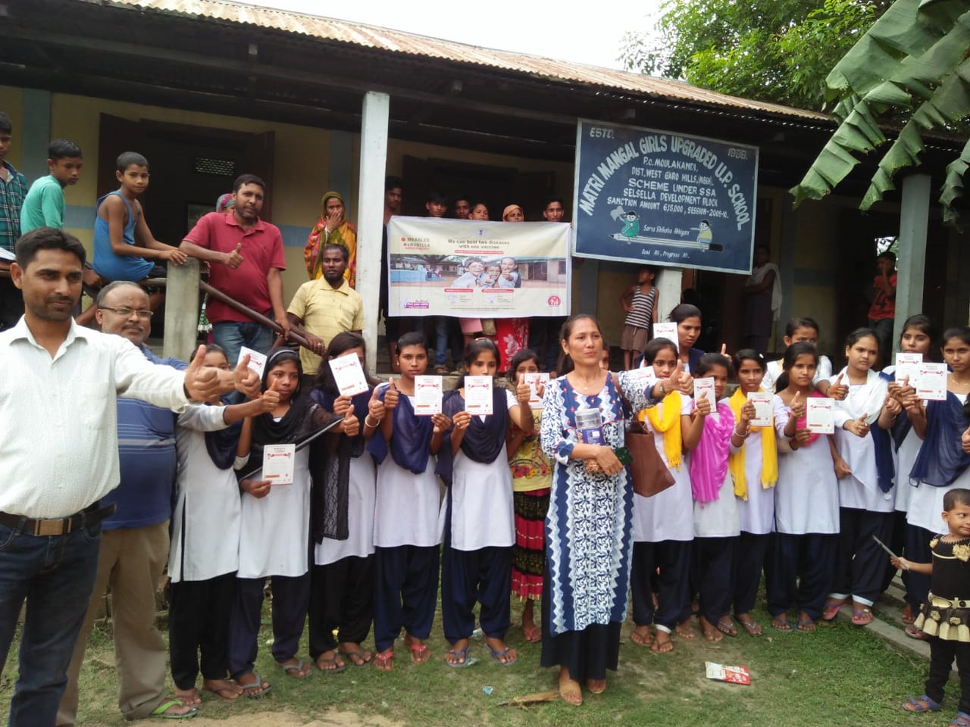
Health Screening

Slide 16
PAB Budget Approval-2019-20
Rs. In Lakhs
Component | Central | State | Total
A) Recurring Assistance
Cost of Foodgrain | 378.11 | 0.00 | 378.11
Conversion Cost | 4926.39 | 551.29 | 5477.68
Honorarium to cooks | 1669.23 | 185.47 | 1854.70
Transportation Assistance | 243.25 | 0.00 | 243.25
MME | 194.85 | 0.00 | 194.85
Total | 7411.83 | 736.76 | 8148.59
B. Non-Recurring Central Assistance
Kitchen Sheds | 0.00 | 0.00 | 0.00
Repair of kitchen-cum-store | 305.10 | 33.90 | 339.00
Kitchen Devices (New) | 10.08 | 1.12 | 11.20
Kitchen Devices (Replacement) | 48.42 | 5.38 | 53.80
B. Total | 363.60 | 40.40 | 404.00
G. Total (A+B) | 7775.43 | 777.16 | 8552.59

Slide 17
Fund Received during 2019-20 from Central & State Government
Particulars | Amount (In Lakhs) |  |  | Date of Releasing
 | Central | State Share | Total | Central | State
Opening Balance (as on 1.4.2019) | 60.33 | 10.34
A. Recurring Funds
Adhoc Installment | 1751.30 | 177.50 | 1928.80 | 01.05.2019 | 19.06.2019
Balance of 1st Installment | 2701.54 | 263.83 | 2965.37 | 11.09.2019 | 17.10.2019
2nd Installment | 3019.39 | 299.86 | 3319.25 | 23.12.2019 | 17.02.2020
B. Non-Recurring Funds
Kitchen Devices | 58.50 | 6.50 | 65.00 | 26.12.2019 | 17.2.2020
Kitchen Repair | 305.10 | 33.90 | 339.00 | 19.3.2020 | 31.3.2020
Total (A+B) | 7835.83 | 781.59 | 8617.42
Total Fund Avialable | 7896.16 | 791.93 | 8688.09

Slide 18
Financial Target Vs. Achievement of (Amount in Lakhs as on 31st December 2019)
Component | Budget Provision (Financial Target as per PAB) |  |  | Financial Expenditure |  |  | % of Utilisation
 | Central | State | Total | Central | State | Total
A) Recurring Assistance
Cost of Foodgrain | 378.11 | 0.00 | 378.11 | 300.19 | 0.00 | 300.19 | 79.39%
Conversion Cost | 5077.63 | 565.53 | 5643.16 | 3665.19 | 408.24 | 4073.43 | 72.18%
Honorarium to cooks | 1669.23 | 185.47 | 1854.70 | 1318.81 | 146.54 | 1465.34 | 79.01%
Transportation Assistance | 243.25 | 0.00 | 243.25 | 141.68 | 0.00 | 141.68 | 58.24%
MME | 194.85 | 0.00 | 194.85 | 94.19 | 0.00 | 94.19 | 48.34%
Total | 7563.07 | 751.00 | 8314.07 | 5520.06 | 554.78 | 6074.83 | 73.07%
B. Non-Recurring Central Assistance
Kitchen Sheds | 0.00 | 0.00 | 0.00 | 0.00 | 0.00 | 0.00 | 0.00%
Kitchen Devices | 58.50 | 6.50 | 65.00 | 0.00 | 0.00 | 0.00 | 0.00%
Repair of kitchen-cum-store | 305.10 | 33.90 | 339.00 | 0.00 | 0.00 | 0.00 | 0.00%
B. Total | 363.60 | 40.40 | 404.00 | 0.00 | 0.00 | 0.00 | 0.00%
G. Total (A+B) | 7926.67 | 791.40 | 8718.07 | 5520.06 | 554.78 | 6074.83 | 69.68%

Slide 19
Financial Target Vs. Achievement of (Amount in Lakhs as on 31st March 2020)
Component | Budget Provision (Financial Target as per PAB) |  |  | Financial Expenditure |  |  | % of Utilisation
 | Central | State | Total | Central | State | Total
A) Recurring Central Assistance
Cost of Foodgrain | 378.11 | 0.00 | 378.11 | 369.75 | 0.00 | 369.75 | 97.79%
Conversion Cost | 5077.63 | 565.53 | 5643.16 | 5026.02 | 559.80 | 5585.82 | 98.98%
Honorarium to cooks | 1669.23 | 185.47 | 1854.70 | 1649.17 | 183.24 | 1832.41 | 98.80%
Transportation Assistance | 243.25 | 0.00 | 243.25 | 236.13 | 0.00 | 236.13 | 97.07%
MME | 194.85 | 0.00 | 194.85 | 185.31 | 0.00 | 185.31 | 95.11%
Total | 7563.07 | 751.00 | 8314.07 | 7466.38 | 743.04 | 8209.42 | 98.74%
B. Non-Recurring Central Assistance
Kitchen Sheds | 0.00 | 0.00 | 0.00 | 0.00 | 0.00 | 0.00 | 0.00%
Repair of kitchen-cum-store | 305.10 | 33.90 | 339.00 | 0.00 | 0.00 | 0.00 | 0.00%
Kitchen Devices (New) | 10.08 | 1.12 | 11.20 | 10.08 | 1.12 | 11.20 | 0.00%
Kitchen Devices (Replacement) | 48.42 | 5.38 | 53.80 | 48.42 | 5.38 | 53.80 | 0.00%
B. Total | 363.60 | 40.40 | 404.00 | 58.50 | 6.50 | 65.00 | 0.00%
G. Total (A+B) | 7926.67 | 791.40 | 8718.07 | 7524.88 | 749.54 | 8274.42 | 94.91%

Slide 20
Proposal for 2020-21

Slide 21
Propose Institutions 2020-21
Sl. No. | Category | State Proposal | Recommended By Appraisal Team
1 | Primary | 8387 | 8376
2 | Upper Primary | 3441 | 3427
 | Total | 11828 | 11803
25 RKM Schools are not recommended as they have got support from the Ministry of Tribal Affairs

Slide 22
Proposed Physical for 2020-21
S. No | Component | State Proposal | Recommended By Appraisal Team
1 | Children (Pry) | 415093 | 385403
2 | Children (U Pry) | 177232 | 148864
Total Children |  | 592325 | 534267
3 | Working Days (Primary & Up.Pry) | 200-Pry | 200-Pry
 |  | 220-U.Pry | 220-U.Pry
4 | Cook cum Helpers | 18547 | 18547
5 | Kitchen cum Store | NIL | NIL
6 | New Kitchen Devices | 19 | 19
7 | Kitchen Devices replacement | 615 | 615
Notes:
22

Slide 23
Proposed Rate Cost for 2020-21
S. No | Component | State Proposal | Recommended By Appraisal Team
1 | Cost of Foodgrain | Rs.3,000/- per MTS | Rs.3000/- per MTs
2 | Cooking Cost Pry | Rs.4.97/- per child per day | Rs.4.97/- per child per day
3 | Cooking Cost Up.Pry | Rs.7.45/- per child per day | Rs.7.45/- per child per day
4 | Cook cum Helpers | Rs.3,000/- per month for 12 months | Rs.1,000/- Per month for 10 months
5 | Transportation Assistance | Rs.1,930/- per MTs | Rs.1,930/- per MTs
6 | Kitchen cum Store | As per Plinth Area Norms | As per Plinth Area Norms
7 | New Kitchen Devices | As per Norms | As per Norms
8 | Kitchen Devices replacement | As per Norms | As per Norms
Notes:
23

Slide 24
Financial Proposal for 2020-21
Rs. In Lakhs
Recurring Central and State Assistance
Sl. No | Components | State Proposal |  |  | Recommended By Appraisal Team
 |  | Central | State | Total | Central | State | Total
Recurring Assistance
1 | Cost of Foodgrain | 424.65 | 0.00 | 424.65 | 378.62 | 0.00 | 378.62
2 | Cooking Cost | 6325.32 | 707.75 | 7033.07 | 5639.76 | 631.03 | 6270.79
3 | Honorarium to Cook-cum-Helper | 6133.97 | 681.55 | 6815.52 | 1669.23 | 185.47 | 1854.70
4 | Transportation Assistance | 273.19 | 0.00 | 273.19 | 243.58 | 0.00 | 243.58
5 | MME | 355.24 | 0.00 | 355.24 | 214.14 | 0.00 | 214.14
Non Recurring Assistance
6 | Kitchen-cum-Store | 405.00 | 44.73 | 449.73 | 0.00 | 0.00 | 0.00
7 | Kitchen Devices (New) | 165.24 | 18.36 | 183.60 | 2.03 | 0.23 | 2.25
8 | Kitchen Devices (Replacement) | 0.00 | 0.00 | 0.00 | 67.10 | 7.46 | 74.55
Total |  | 14082.61 | 1452.39 | 15535.00 | 8214.44 | 824.18 | 9038.62

Slide 25
Proposal for Coverage of Pre-Primary attached to Primary Schools

Slide 26
Number of Pre-Primary Schools Proposed to be Covered in 2020-21
S.No. | Name of District | Pre Primary School attached to Primary School |  |  | Enrolment
 |  | Govt + SSA | Govt. Aided | Total | Govt + SSA | Govt. Aided | Total
1 | 2 | 3 | 4 | 5 | 6 | 7 | 8
1 | East Khasi Hills | 464 | 528 | 992 | 17209 | 22729 | 39938
2 | Ri Bhoi | 349 | 141 | 490 | 9568 | 4710 | 14278
3 | West Khasi Hills | 369 | 385 | 754 | 9122 | 9263 | 18385
4 | South West Khasi Hills | 172 | 162 | 334 | 3618 | 3076 | 6694
5 | West Jaintia Hills | 491 | 163 | 654 | 12708 | 2593 | 15301
6 | East Jaintia Hills | 344 | 96 | 440 | 9090 | 2343 | 11433
7 | East Garo Hills | 331 | 57 | 388 | 6078 | 1035 | 7113
8 | North Garo Hills | 306 | 101 | 407 | 6133 | 2237 | 8370
9 | West Garo Hills | 721 | 112 | 833 | 18537 | 2945 | 21482
10 | South West Garo Hills | 180 | 47 | 227 | 2165 | 2017 | 4182
11 | South Garo Hills | 426 | 89 | 515 | 6915 | 1670 | 8585
Total |  | 4153 | 1881 | 6034 | 101143 | 54618 | 155761

Slide 27
Physical
Proposed no of Children : 155761
Foodgrain proposed : 3115.22 MTs
Financial ( In Lakhs)
Component | Cental | State | Total
Cost of Foodgrain | 93.46 | 0.00 | 93.46
Cooking Cost | 1367.58 | 190.03 | 1557.61
Transport Assistance | 60.12 | 0.00 | 60.12
MME | 41.07 | 0.00 | 41.07
Total | 1562.23 | 190.03 | 1752.26

Slide 28
Total Financial Requirement Including Pre-Primary Children
Category | Central Share | State Share | Total
Elementary | 15739.80 | 1728.20 | 17467.95
Pre-Primary | 1562.23 | 190.03 | 1752.26
Total | 17301.98 | 1918.23 | 19220.21

Slide 29
THANK YOU

